Slide 1

CLASSIFICATION OF SOUTH GERMAN
CREDIT RISK
Project Supervisor : Dr. R.M.Gomathi
Name of the Student : Akula Sravanth Satya Ramki
Register Number : 39120119

Slide 2

Course Certificate

Slide 3
Introduction
When a bank receives a loan application, based on the applicant’s profile the bank has to make a decision regarding whether to go ahead with the loan approval or not.
If the applicant is a good credit risk, i.e. is likely to repay the loan .If the applicant is a bad credit risk, i.e. is not likely to repay the loan
This study aims at adressing this classification problem by using the the applicant’s demographic and socio-economic profiles of this dataset to examine the risk of lending loan to the customer.
we try to minimize the risk and maximize of profit for the bank. To minimize loss from the bank’s perspective, the bank needs a decision rule regarding who to give approval of the loan.
This Report Includes brief introduction of South German Credit Data Set Using Decision Tree.

Slide 4
Problem Statement
In South German Credit, we need to classify the Credit Risk as Good credit Risk or Bad Credit Risk for further analysis. The South German Credit data set is a publicly available data set.

Slide 5
Objectives
From this dataset we have to find the credit risk is good or bad

Slide 6
System Architecture
Gathering
The data
Calcuating the
Recall and Precision
Values of Decision Tree Algorithm
Constructing the
Confusion Matrix
Understanding
The Data
Data Preprocessing
And Explorators
Data Analysis
Training And
Testing the Data
Calcuating The
Accuracy of the
Dataset with Decission Tree Algorithm

Slide 7
Decision Tree
Decision Tree is a Supervised learning technique that can be used for both classification and Regression problems, but mostly it is preferred for solving Classification problems.
It is a tree-structured classifier, where internal nodes represent the features of a dataset, branches represent the decision rules and each leaf node represents the outcome.
In a Decision tree, there are two nodes, which are the Decision Node and Leaf Node
It is a graphical representation for getting all the possible solutions to a problem/decision based on given conditions.

Slide 8

Decision Tree
general structure of a decision tree :

Slide 9
Project Implementation
Hardware Requirements :
4gb RAM,Operating System,Windows 10,
Intel i5,10 Generation.
Software Requirements:
Anaconda ipyKernal,
Python 3.8

Slide 10
Understanding the Data
This section contains a brief description for each attribute.
The given dataset contains 800 rows and 22 columns. The first 21 columns are features, the last column contains the classification label of ‘0's and ‘1’.

Slide 11
Understanding the Data (Attribute Information)
Column name: laufkont Variable name: status Content: status of the debtor's checking account with the bank
Column name: laufzeit Variable name: duration Content: credit duration in months
Column name: moral Variable name: credit_history Content: history of compliance with previous or concurrent credit contracts
Column name: verw Variable name: purpose Content: purpose for which the credit is needed (categorical) Column name: hoehe Variable name: amount Content: credit amount in DM (quantitative; result of monotonic transformation; actual data and type of transformation unknown) Column name: sparkont Variable name: savings Content: debtor's savings

Slide 12
Understanding the Data (Attribute Information)
Column name: beszeit Variable name: employment_duration Content: duration of debtor's employment with current employer (ordinal; discretized quantitative)
Column name: rate Variable name: installment_rate Content: credit installments as a percentage of debtor's disposable income (ordinal; discretized quantitative)
Column name: famges Variable name: personal_status_sex Content: combined information on sex and marital status; categorical; sex cannot be recovered from the variable, because male singles and female non-singles are coded with the same code (2); female widows cannot be easily classified, because the code table does not list them in any of the female categories
Column name: buerge Variable name: other_debtors Content: Is there another debtor or a guarantor for the credit? (categorical)
Column name: wohnzeit Variable name: present_residence Content: length of time (in years) the debtor lives in the present residence (ordinal; discretized quantitative)

Slide 13
Understanding the Data (Attribute Information)
Column name: verm Variable name: property Content: the debtor's most valuable property, i.e. the highest possible code is used. Code 2 is used, if codes 3 or 4 are not applicable and there is a car or any other relevant property that does not fall under variable sparkont. (ordinal)
Column name: alter Variable name: age Content: age in years (quantitative)
Column name: weitkred Variable name: other_installment_plans Content: installment plans from providers other than the credit-giving bank (categorical)
Column name: wohn Variable name: housing Content: type of housing the debtor lives in (categorical)
Column name: bishkred Variable name: number_credits Content: number of credits including the current one the debtor has (or had) at this bank (ordinal, discretized quantitative); contrary to Fahrmeir and HamerleÃ¢â‚¬â„¢s (1984) statement, the original data values are not available.
Column name: beruf Variable name: job Content: quality of debtor's job (ordinal)

Slide 14
Understanding the Data (Attribute Information)
Column name: pers Variable name: people_liable Content: number of persons who financially depend on the debtor (i.e., are entitled to maintenance) (binary, discretized quantitative)
Column name: telef Variable name: telephone Content: Is there a telephone landline registered on the debtor's name? (binary; remember that the data are from the 1970s)
Column name: gastarb Variable name: foreign_worker Content: Is the debtor a foreign worker? (binary)
Column name: kredit Variable name: credit_risk Content: Has the credit contract been complied with (good) or not (bad)

Slide 15
Data Preprocessing and Exploratory Data Analysis
The given dataset contains 21 features. Before diving into the feature importance, to find out which feature is more useful and which one is not, do a random data analysis.
We will convert the dataset into a pandas data frame and perform further processing. After converting into a pandas data frame, we will drop any duplicate rows in our dataset. Hence the final data frame has 800 rows and 20 columns.

Slide 16
Modules And Libraries Used
Numpy
Pandas
Matplotlib
Seaborn
Plotly
Sklearn (ML)

Slide 17
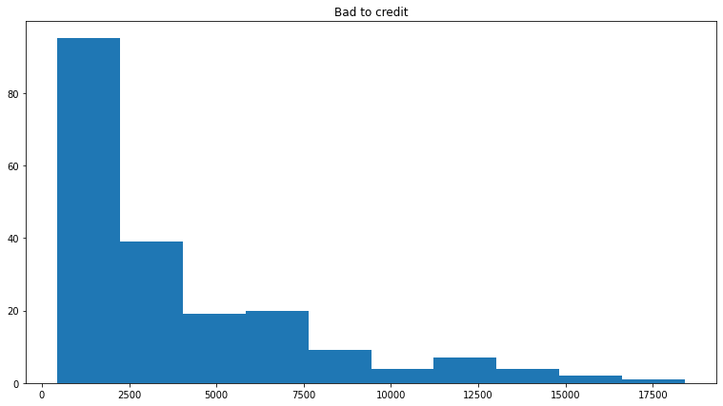
Histogram on Amount
Below plot is based on the Loan Amount
The badloans is right skewed and with maximum bad loans under 7500
Highest bad loan could be for the business (can be checked quickly)

Slide 18
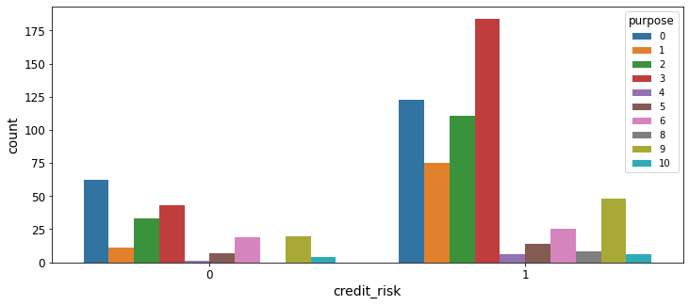
Purpose (based on credit risk)
Count plot :

Slide 19
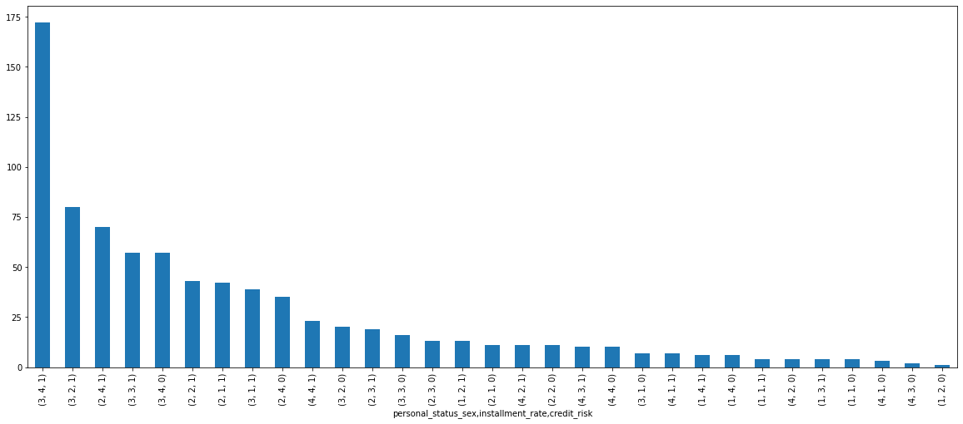
Sex With Credit Risk Based On Installment_rates
Credit risk is with Gender on Installment Rates
Bar plot :

Slide 20
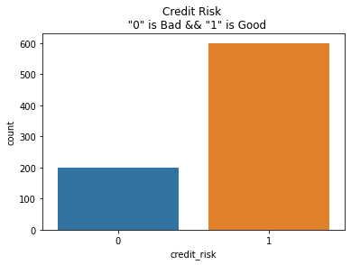
Credit Risk (count plot)

Slide 21
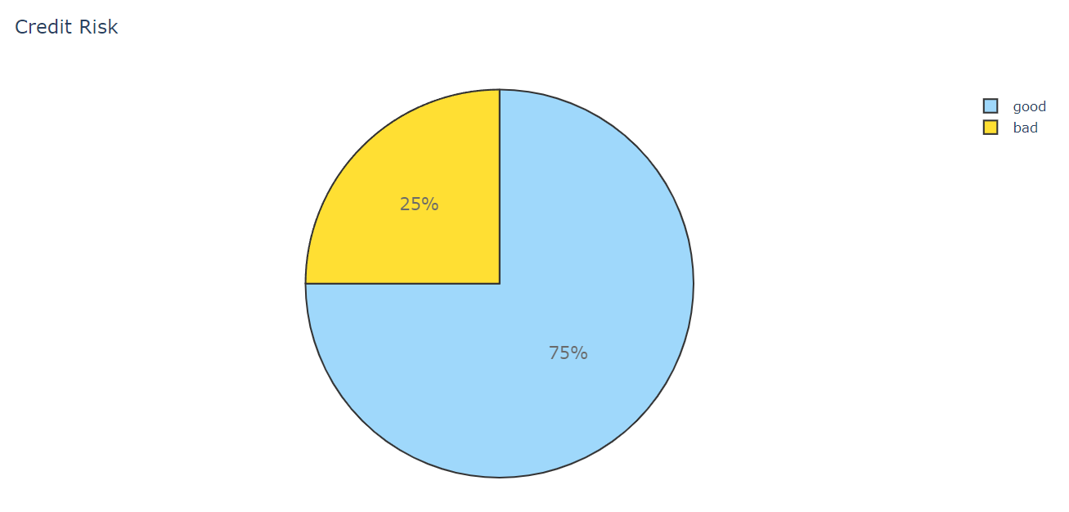
Credit Risk (pie chart)

Slide 22
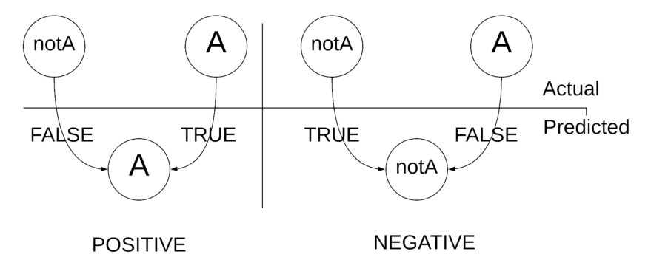
Confusion Matrix
Confusion Matrix there are some keywords you should have to understand. Those are .“ True “, “ False “, “ Negative “, and “ Positive “.
Let’s talk that with this an example, Imagine the above accuracy scenario and take “A”. When the model says it is “A” it is called a “Positive” outcome or the prediction says it is “ notA” it will be a “Negative” outcome. And also if the “A” is recognized as “notA” or vice versa will be a “False” outcome. So, four types of classes can be recognized.

Slide 23
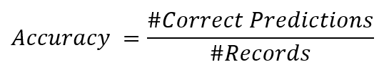
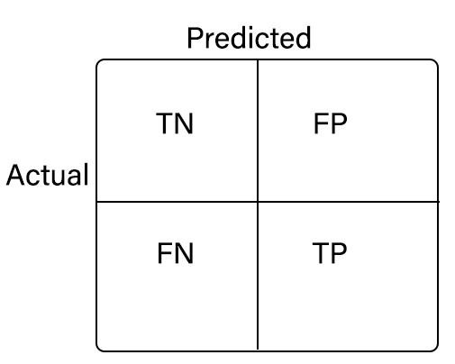
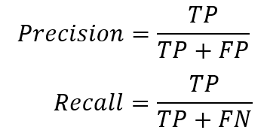
Accuracy,Precision and Recall

Slide 24
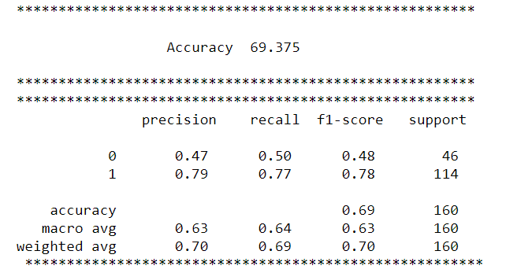
Result

Slide 25
Conclusion
We have modelled the South German Credit Data set using Decision Tree with the accuracy 69.375
In this Project the credit risk is mainly based on the status of the account,Amount,credit history,purpose,age,gender, installment rate and the remaining rows are showing less impact on the project.
In the future we can add more categories, ploting more graphs and make it more user friendly and improves its quality. I and my team members are interested in studying these methods and implement in another Machine learning Algorithms .

Slide 26
References
[1] UCI Machine Learning Repository: Ionosphere Data Set
https://drive.google.com/file/d/1LmZKbq3TPG5KkTGarsoHvhXpAvNb7u4J/view?usp=sharing
[2] For Learning Python Language
https://www.learnpython.org/
[3] Scipy Lectures Notes
http://scipy-lectures.org/_downloads/ScipyLectures-simple.pdf
[4] Git Hub
https://github.com/dabeaz-course/practical-python/blob/master/Notes/Contents.md
[5] Numpy
https://numpy.org/doc/stable/user/quickstart.html

